Slide 1
Software Components

Slide 2
Application Software Component
Introduction
The application layer consists of the specific software components and many applications which perform specific tasks as per instructions.
The AUTOSAR standard specifies the application layer implementation using a “component” concept.
The AUTOSAR application layer consists of three components which are:
Application software components
Ports of software components
Port interfaces
Software Component is not only logic block, it also contains ports, port interfaces, runnable entities, internal behavior, configuration parameters.

Slide 3
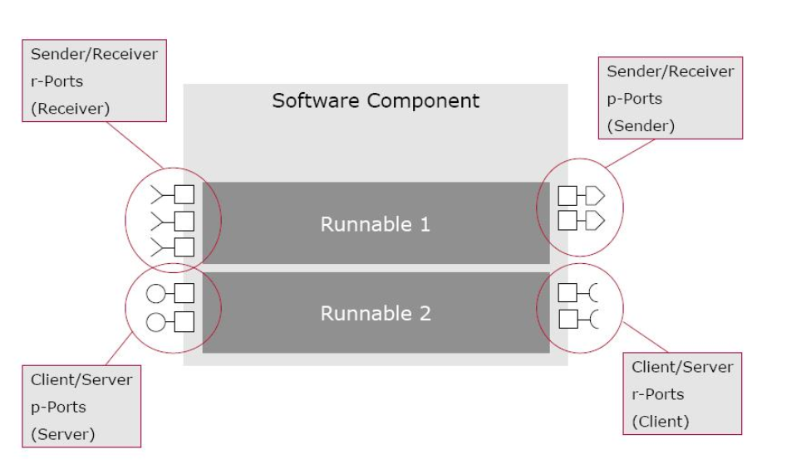
SWC description includes
General characteristics
Name
Manufacturer
Communication properties
P ports
R ports
Interfaces
Inner structure (composition)
Sub-components
Connections
Runnable
Required hardware resources
Processing time
Scheduling
Memory

Slide 4
Types of Software Components
Atomic Component
It cannot be further subdivided and can be assigned to only one ECU.
It implements a part of the application.
Application Component : Implement the algorithm
Sensor/Actuator Component : It handles sensor evaluation and actuator control functions. It depends on associated sensor/actuator and independent of ECU mapped to it.
Composite Component
It offers a logical interconnection of other components, which could be either atomic or composite. It can be deployed in different ECUs
Service component
A service component in AUTOSAR is standardized and uses standardized interfaces to provide services. Direct access to BSW is needed in order to provide these services to other components

Slide 5
Calibration parameter component
To provide values for calibrating all connected components. If all connected components are not located on the same ECU, the calibration parameter component has to be duplicated and placed on every ECU having at least one other component needing it.
ECU Abstraction component
When the sensor-actuator component was described above it was mentioned that it interacted with the ECUAL. To be more precise, it provided access to I/O via a client-server P Port on an ECU abstraction component. This ECU-abstraction component has the ability to interact with other BSW.
Complex device driver component
It can communicate directly with other BSW and is typically used for applications with critical resource demands.
Benefits of SWCs:
Modularity
Portability
Scalability
Interoperability

Slide 6
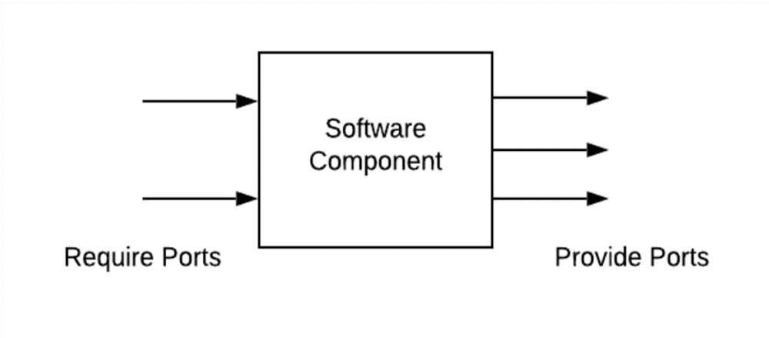
Ports
A port belongs to SWC and it act as the interaction point between a two SWC. A port is associated with a port-interface.
Contents: Data elements (Sender/ Receiver) and Operations (Client / Server).
Provided Ports (P port)
Provided Ports are connection points within a SWC that allow it to expose its services, data, or functionality to other SWCs
Required Ports (R port):
Required Ports are connection points within a SWC that enable it to receive services, data, or functionality from other SWCs

Slide 7
Ports Interfaces
An interface is attached to a port and it describes the data or operations that are provided or required by a SWC via that port. The interface provides a standardized way for components to interact and exchange information.
Types
Sender Receiver Port Interface
Client Server Port Interface

Slide 8
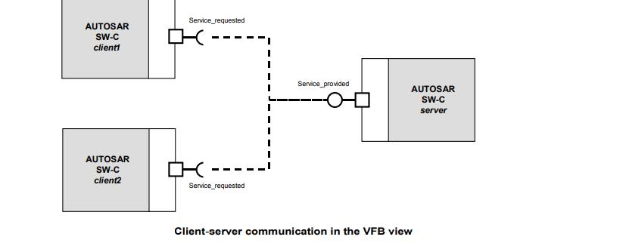
Client Server Port Interface
The server provides services while one or more clients may use its services to carry out tasks.
Contents: Operations
Communication: 1:1 or n:1 (Multiple client to single server)

Slide 9
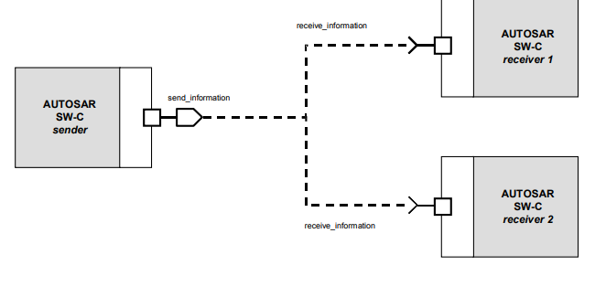
Sender Receiver Port Interface
This way of communicating allows one receiver to get information from multiple senders or a sender to send information to an arbitrary number of receivers.
It defines an asynchronous information distribution and allows for a more data-oriented information exchange over the virtual function bus.
Contents: Data Elements
Communication: 1: n or n:1

Slide 10
Smarter. Greener. Together.

